Slide 1















Facial Recognition System for Automated Classroom Attendance Tracking
SURANDRA MEENA
205122045

Slide 2

INTRODUCTION
Traditional methods of manual attendance tracking in educational
institutions are time-consuming, error-prone, and lack efficiency.
To address these challenges, there is a growing need for automated attendance tracking systems.
This project aims to leverage facial recognition technology to create a system that streamlines the attendance recording process in classrooms.

Slide 3


OBJECTIVES
MAIN OBJECTIVE
SECONDARY OBJECTIVES
Automated Attendance Tracking: Develop a system capable of automatically capturing and recognizing facial features of students at regular intervals (e.g., every 10 minutes) during a class session.
Integration with Database: Implement a robust database to store and manage facial data for enrolled students. Ensure seamless integration between the facial recognition system and the database for real-time attendance updates.
Accuracy and Reliability: Strive for high accuracy in facial recognition to minimize false positives and negatives. Address challenges such as varying lighting conditions, different facial expressions, and potential obstructions.
Scalability: Develop the system in a scalable manner, allowing for easy integration with existing infrastructure in educational institutions and accommodating potential future expansions.
Alerts and Notifications: Implement an alert system to notify instructors or administrators of any discrepancies or anomalies in attendance records. This could include notifications for unrecognized faces or suspicious activities.

Slide 4
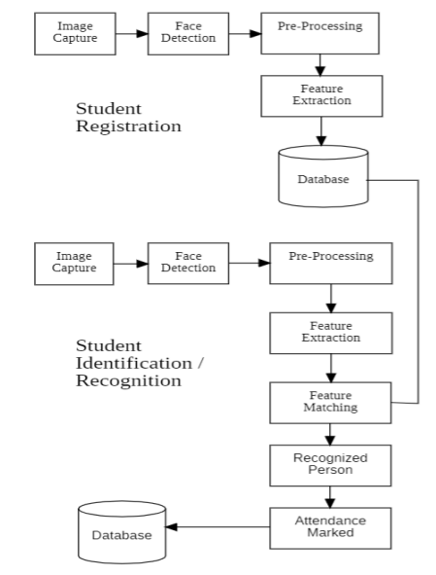
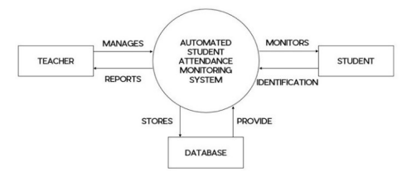
ARCHITECTURE
Diagram

Slide 5
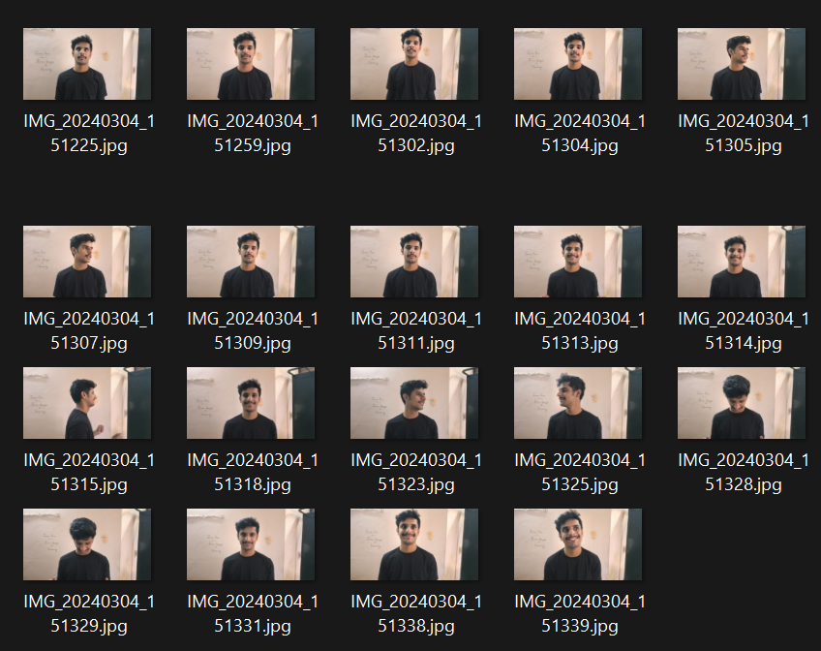
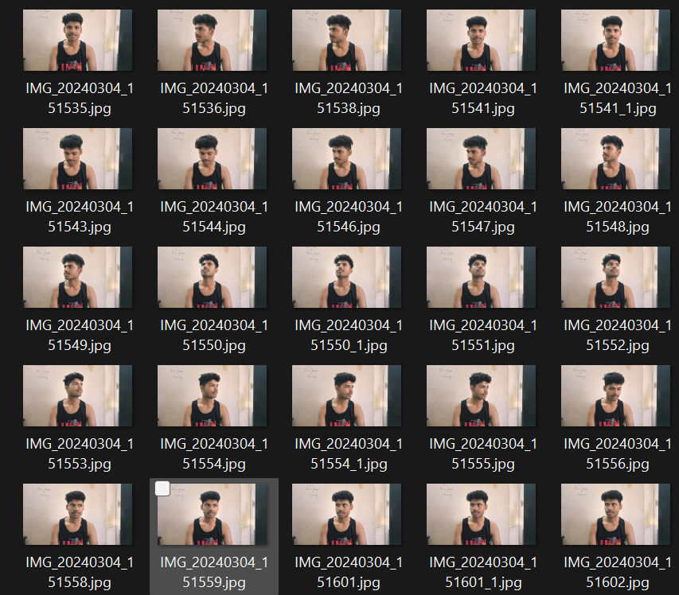
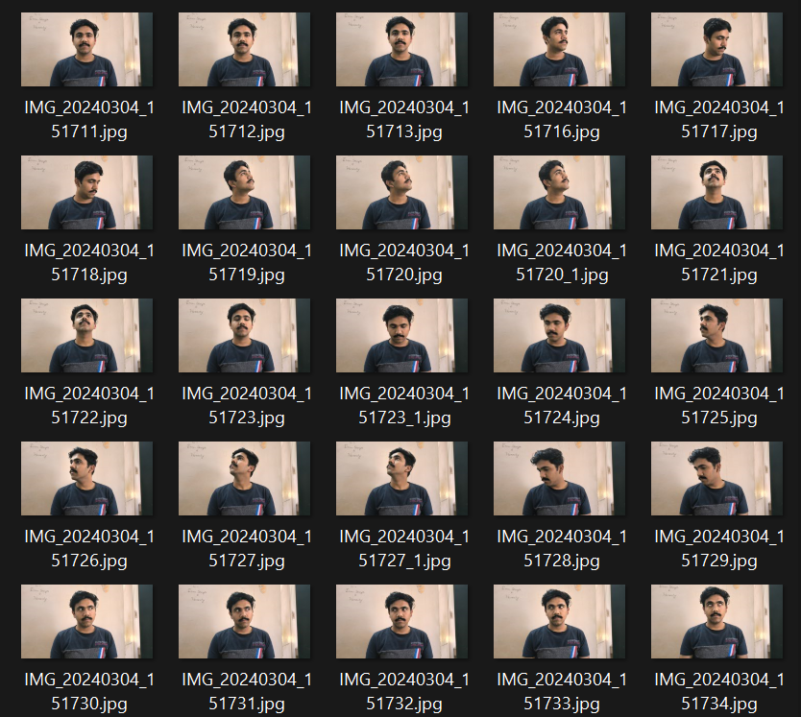
DATASET (PREPROCESSING)
Dataset consist Total 150 Images (6 person X 25 poses).
The Bleow Images was feeded to MTCNN face detection algorithm, for face detection and region of face.

Slide 6
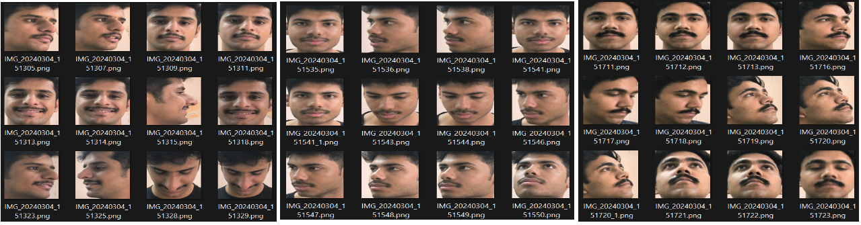
PREPROCESSED DATA
Each Image Size : 120 pixels

Slide 7
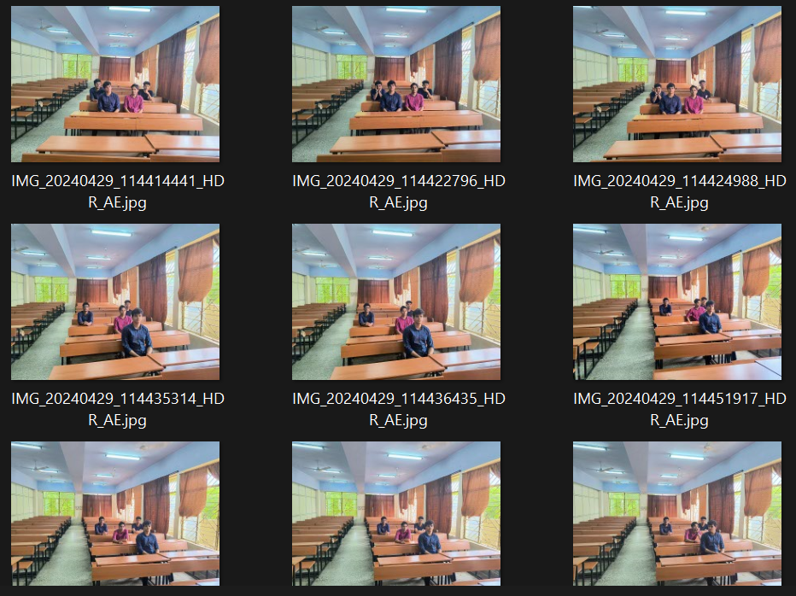
REAL ENVIRONMENT DATASET

Slide 8

FEATURES
Core functionalities:
Face Detection: The system should be able to accurately detect human faces within the classroom environment, even in crowded settings.
Facial Recognition: Upon detection, the system should recognize the student's face and match it against the enrolled student database.
Attendance Recording: Based on successful recognition, the system should automatically mark attendance in the database with timestamps.
Additional features:
Real-time Processing: Minimize latency between face detection, recognition, and attendance recording.
Multi-face Recognition: Identify and record attendance for multiple students simultaneously within the camera's field of view.
Image Capture (Optional): Capture student images during the recognition process for further verification or attendance review (requires student consent).

Slide 9





Web Application Development (Flask):
Flask Framework: Utilize the Flask framework to create a web application.
Homepage: The application will have a homepage for instructors to manage various functionalities.
Student Registration: A functionality to register students.
Data Acquisition and Preprocessing:
Student Images: Collect a set of images (at least 10) for each student.
Organization: Store these images in separate folders named after each student within a designated directory
METHODOLOGY
Face Detection and Alignment:
MTCNN Algorithm: Employ the MTCNN algorithm to detect faces within the raw images. It outputs an "aligned" folder containing cropped and aligned face regions from the raw images. This improves the accuracy of the facial recognition model.
Attendance Capture and Processing:
Image Upload: The application will provide a feature for instructors to upload images.
Real-time Processing: Application will process the image using the trained FaceNet model.
Attendance Marking: Based on successful recognition, the system will mark attendance for the identified students in a database.
Training the Face Recognition Model:
FaceNet Library: train a deep learning model for facial recognition.
Embeddings: FaceNet generates unique 512-dimensional vectors (embeddings) representing each student's facial features.
Training Data: The aligned images and their corresponding labels (student names) are used to train the FaceNet model.
Database Integration:
Student Information: A database (e.g., SQLite) will be used to store student information, including their names and potentially additional details.
Attendance Records: The database will also store attendance records for each student, including timestamps and potentially class information.

Slide 10
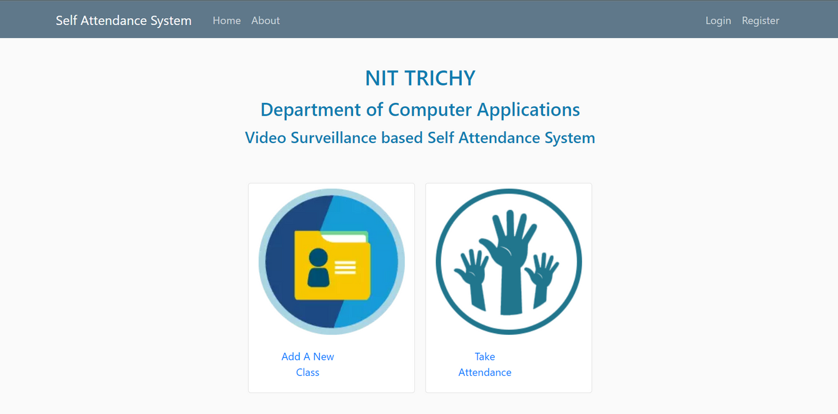
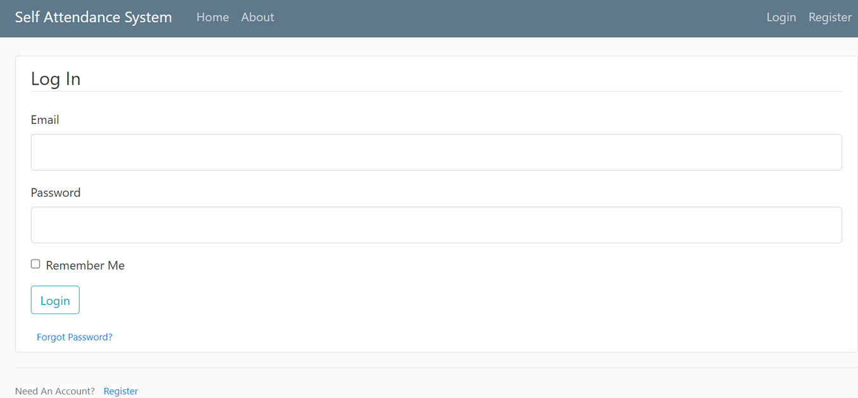
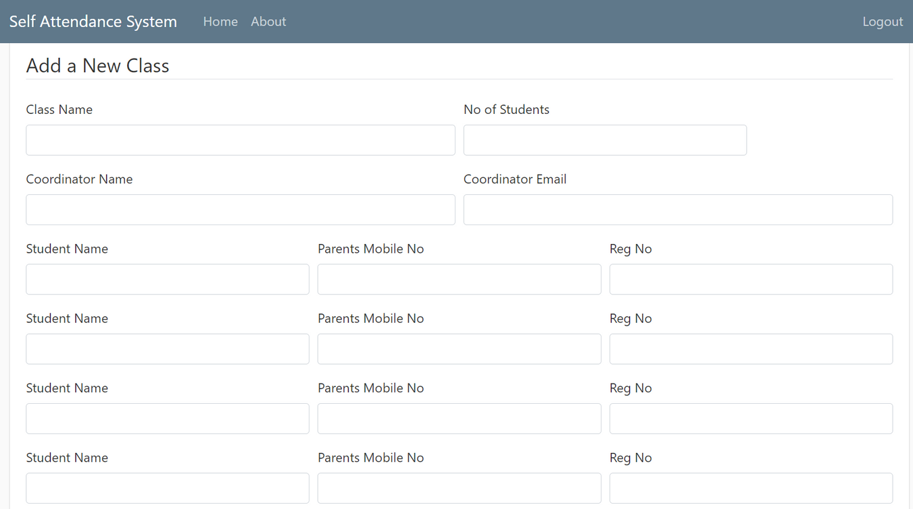
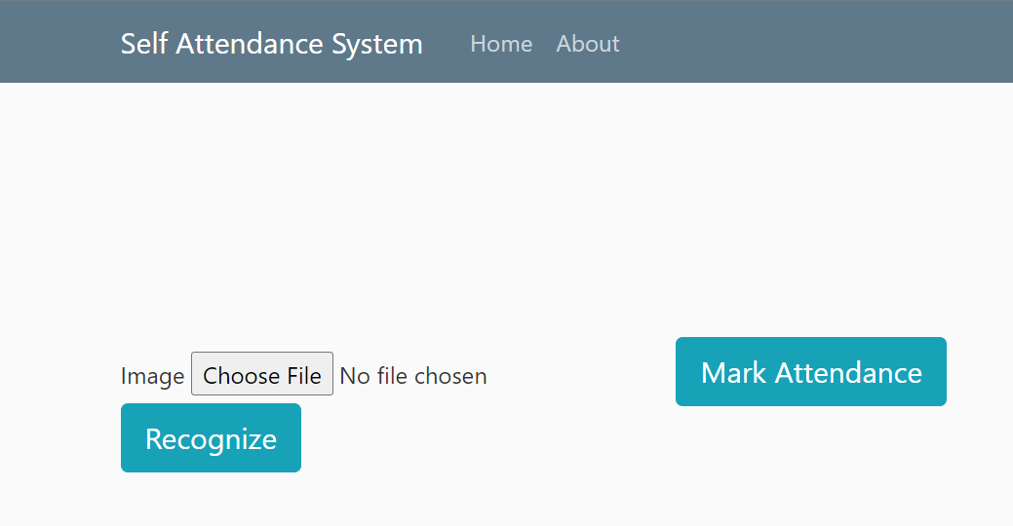
Front End (OLD)
Home Page
Login Page
Add New Class Page
Take Attendance Page

Slide 11
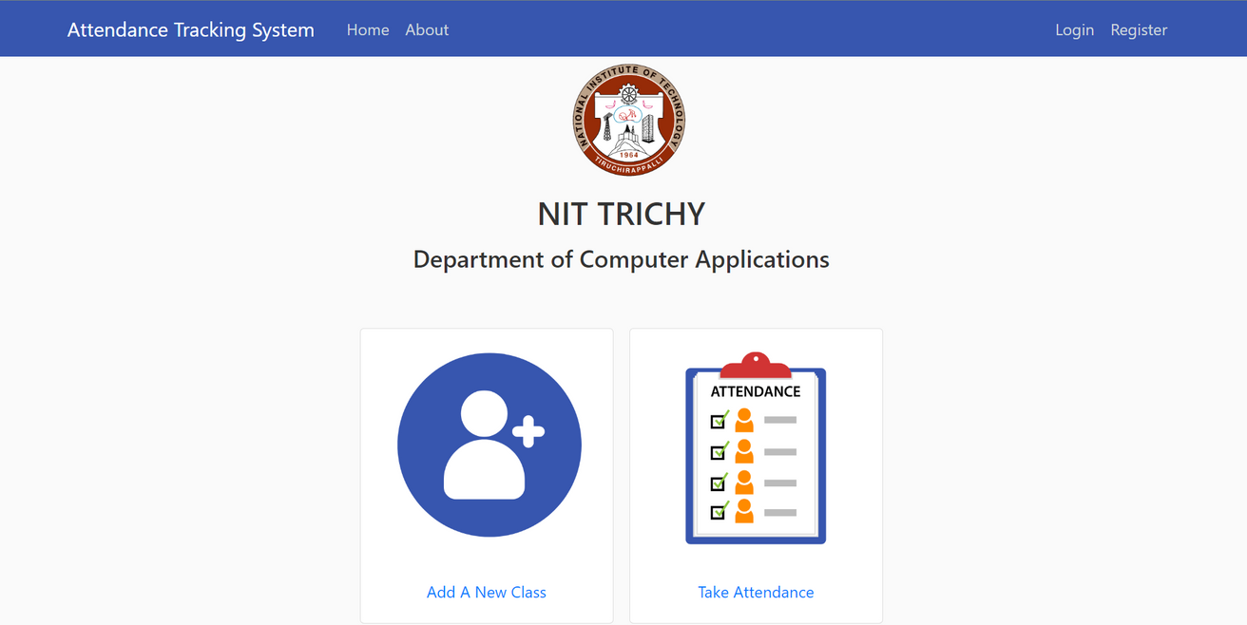
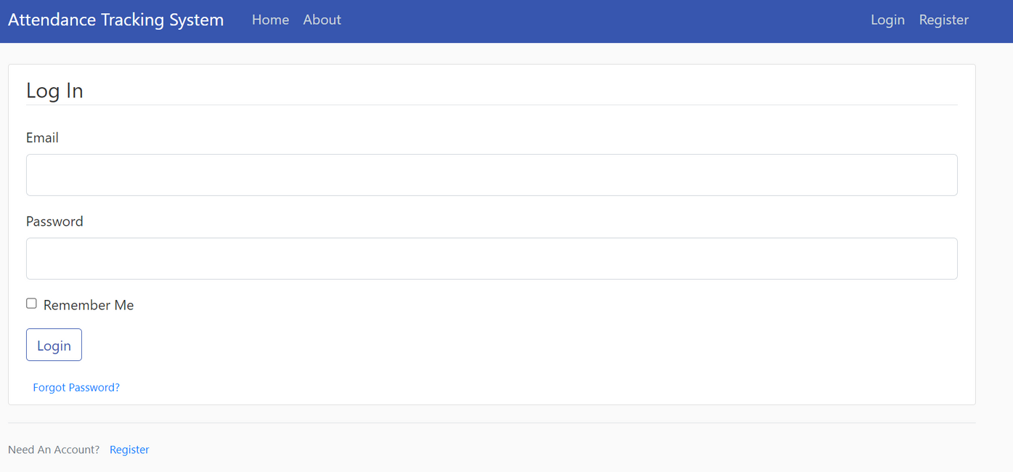
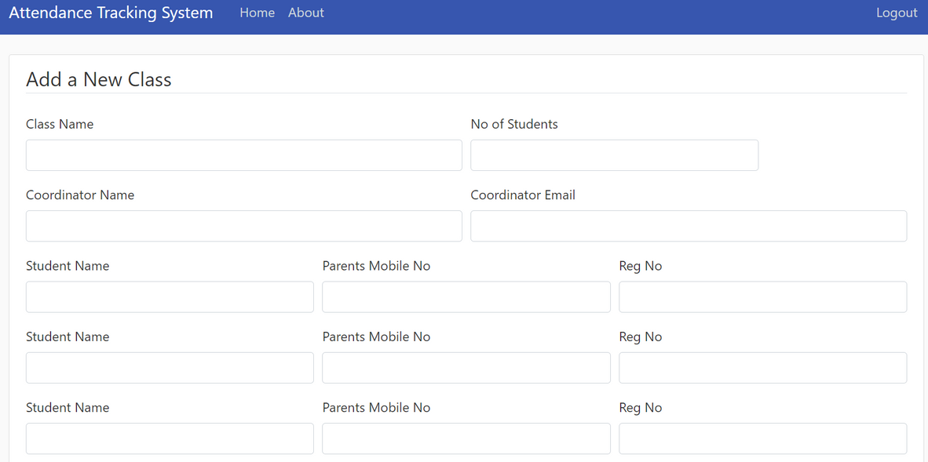
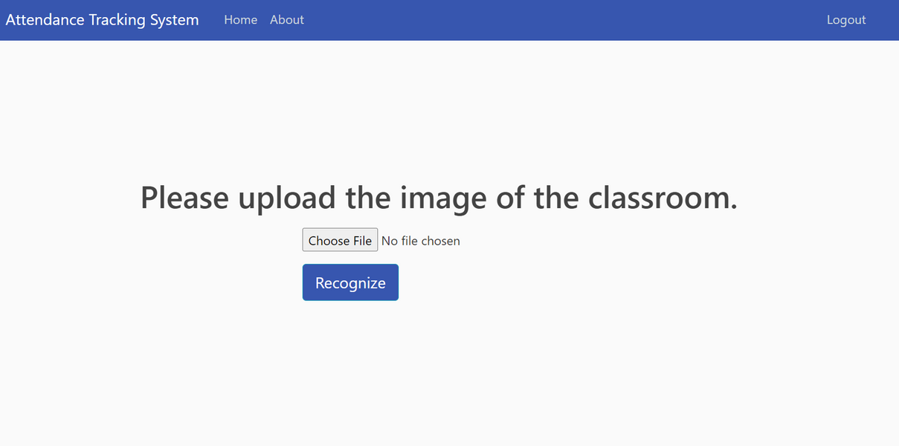
Front End (NEW)
Home Page
Login Page
Add New Class Page
Take Attendance Page

Slide 12

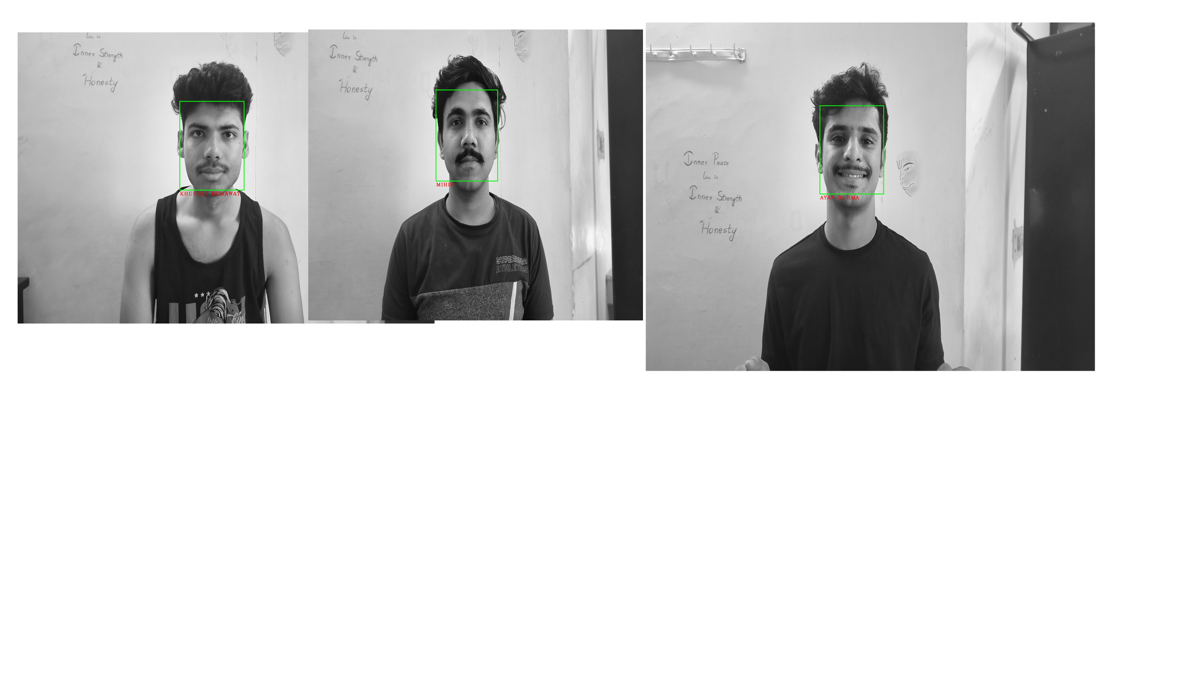

RESULTS AND ANALYSIS (TESTING)
The implemented facial recognition attendance system achieved an accuracy of 94% using an SVM classifier for facial recognition. This result demonstrates a high success rate in recognizing student faces within classroom images.
Recognitions
Attendance Sheet

Slide 13
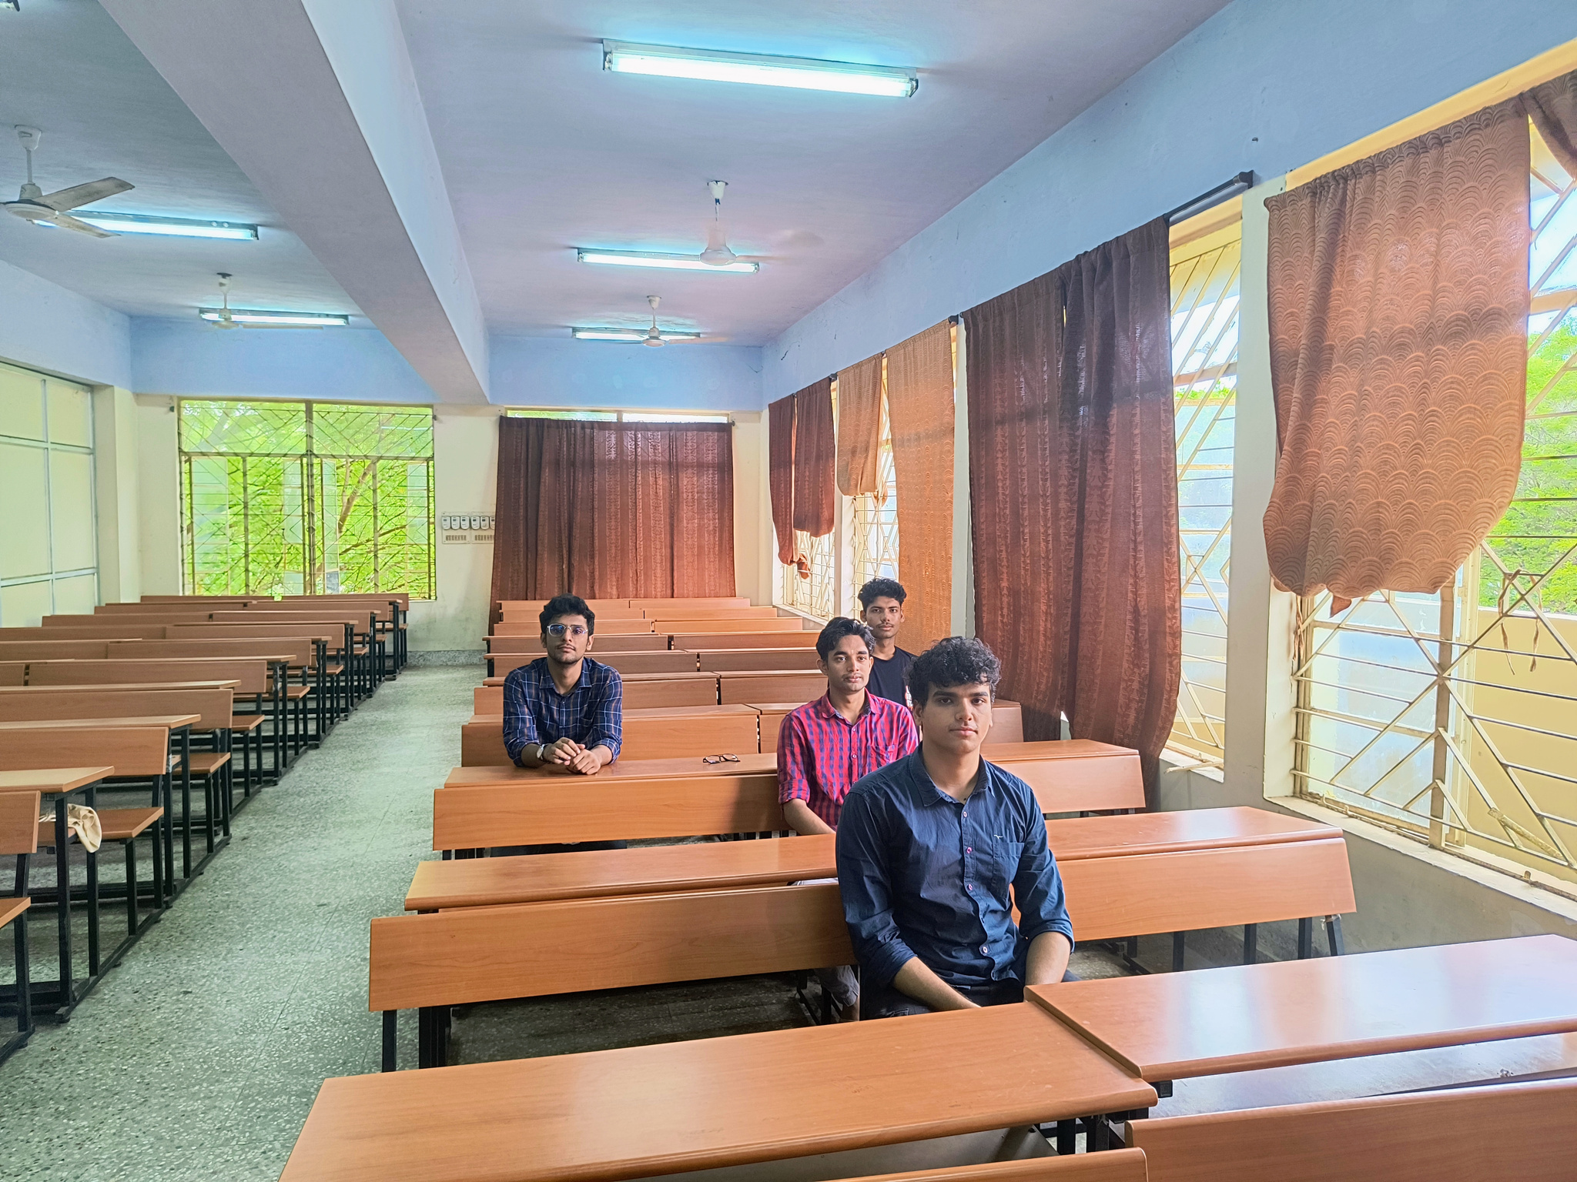
REAL ENVIRONMENT TESTING

Slide 14
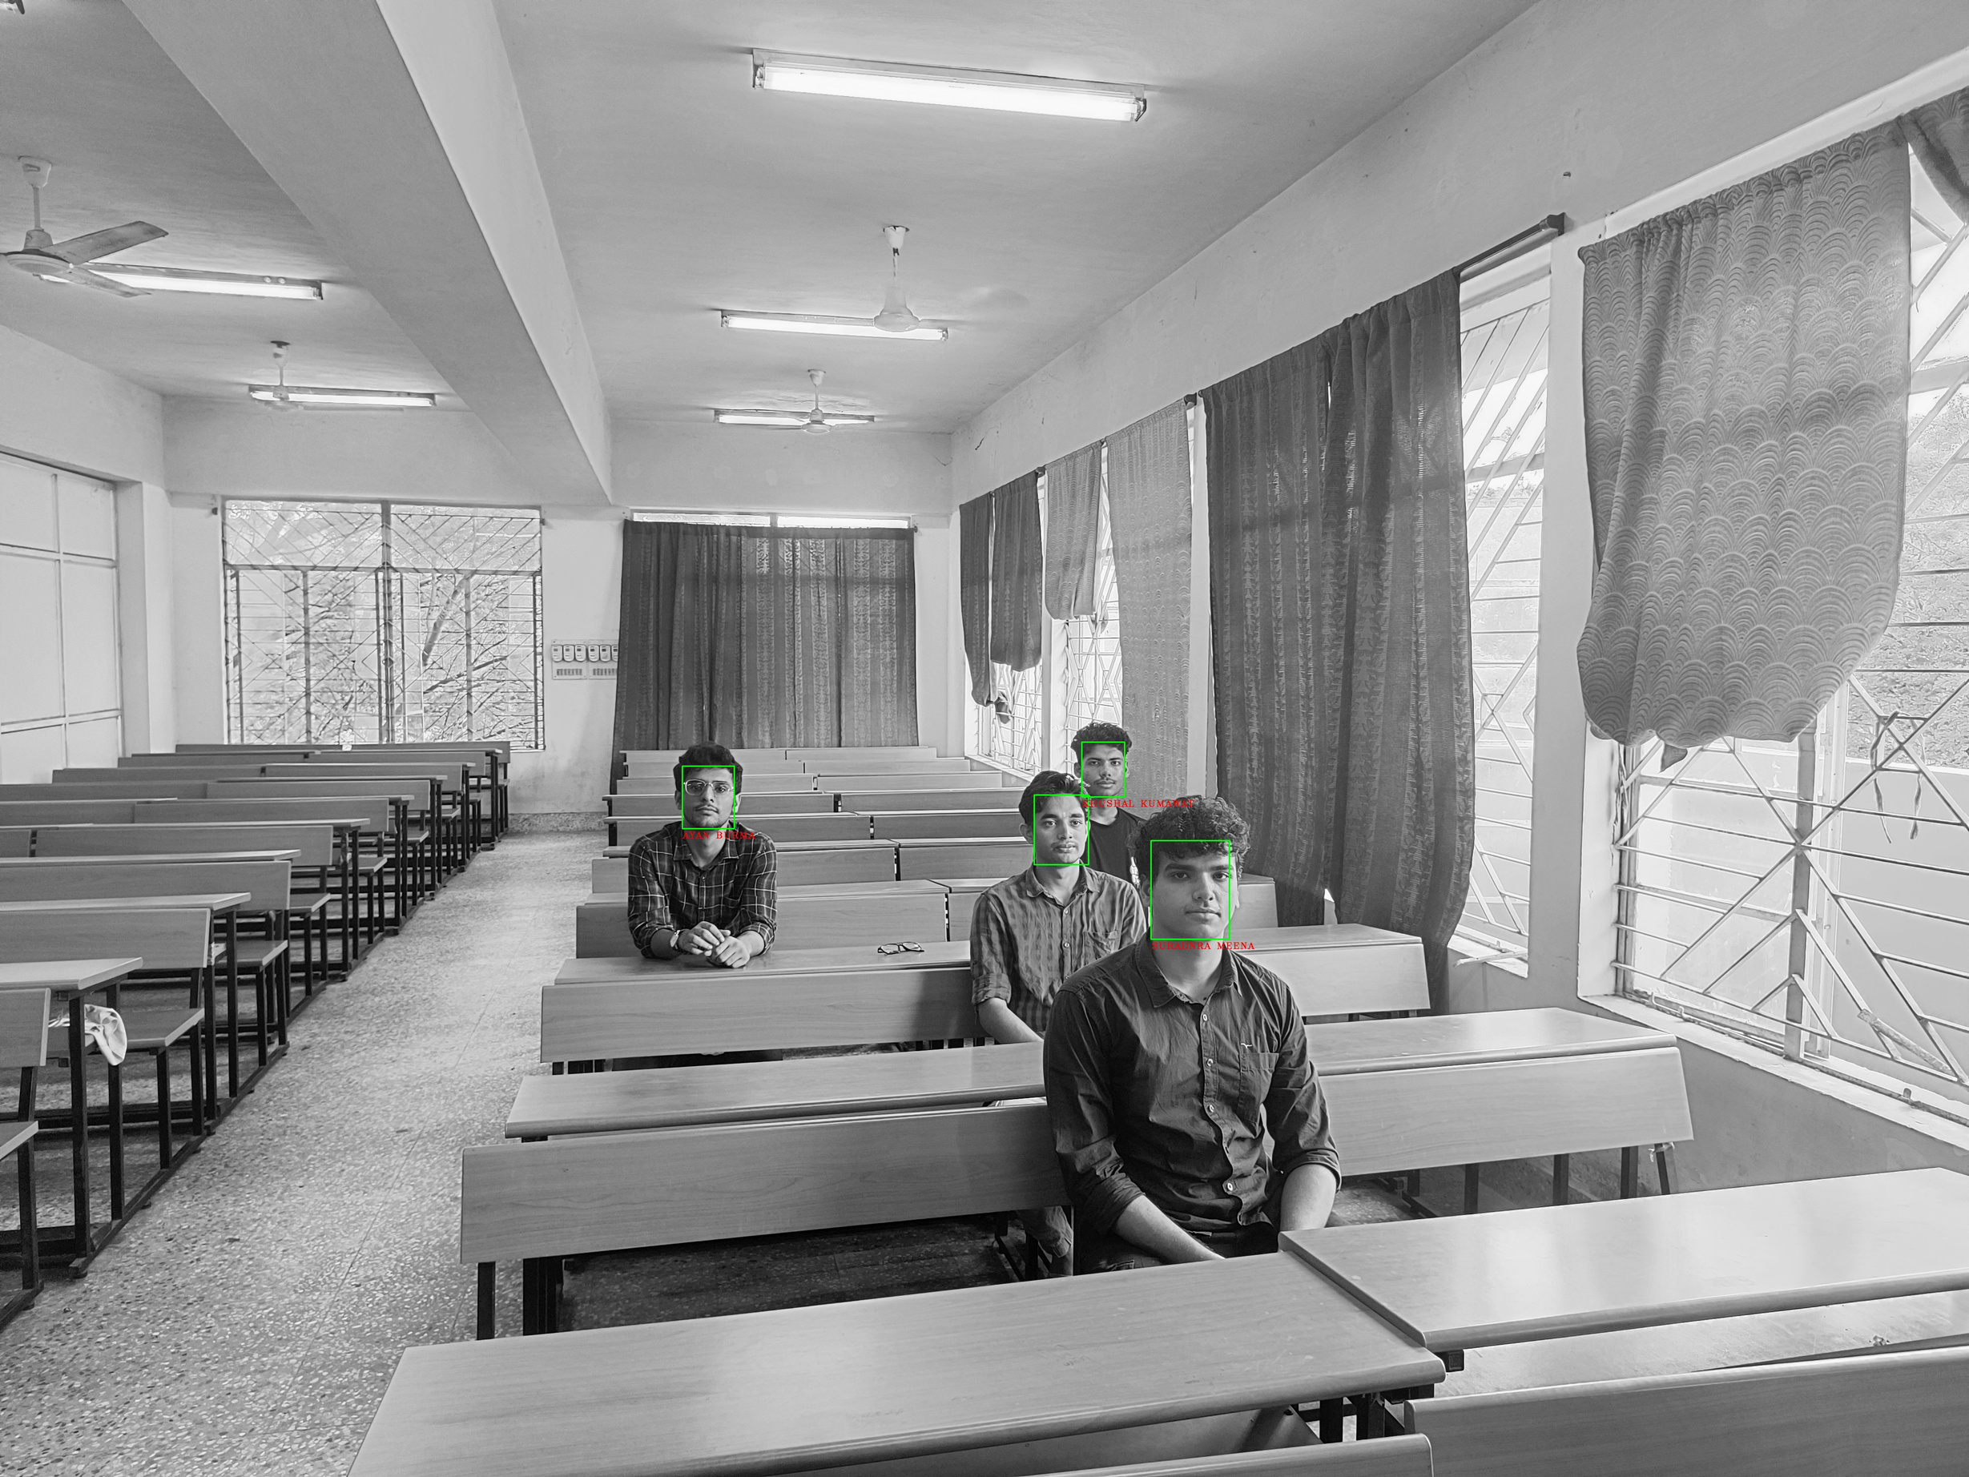
REAL ENVIRONMENT TESTING

Slide 15
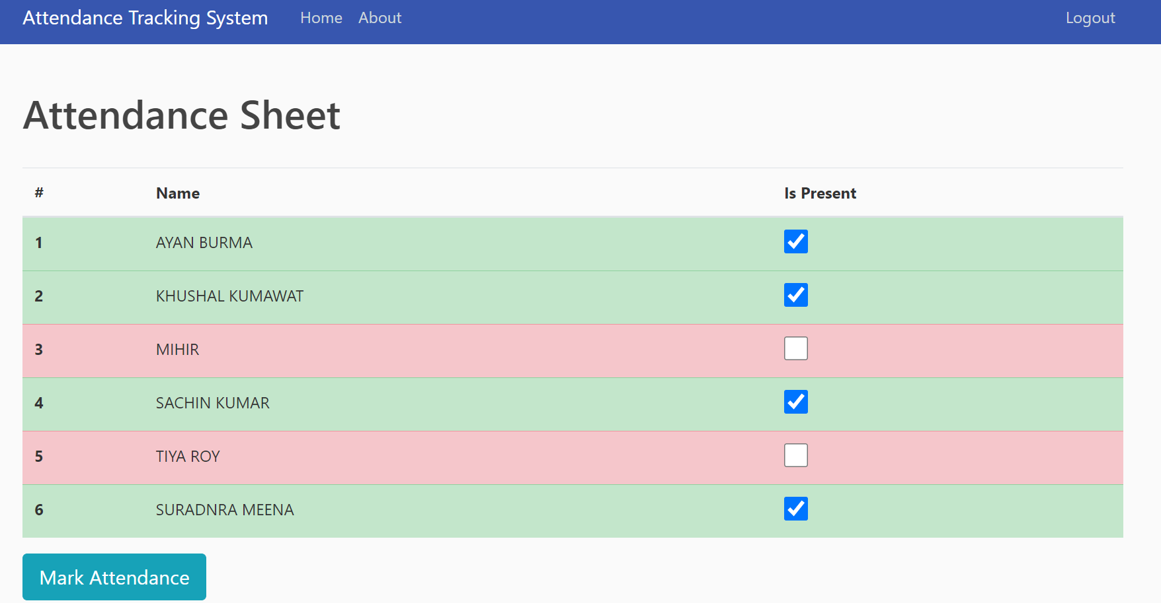
Real Environment Results

Slide 16
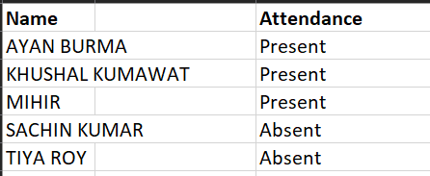
RESULTS

Slide 17
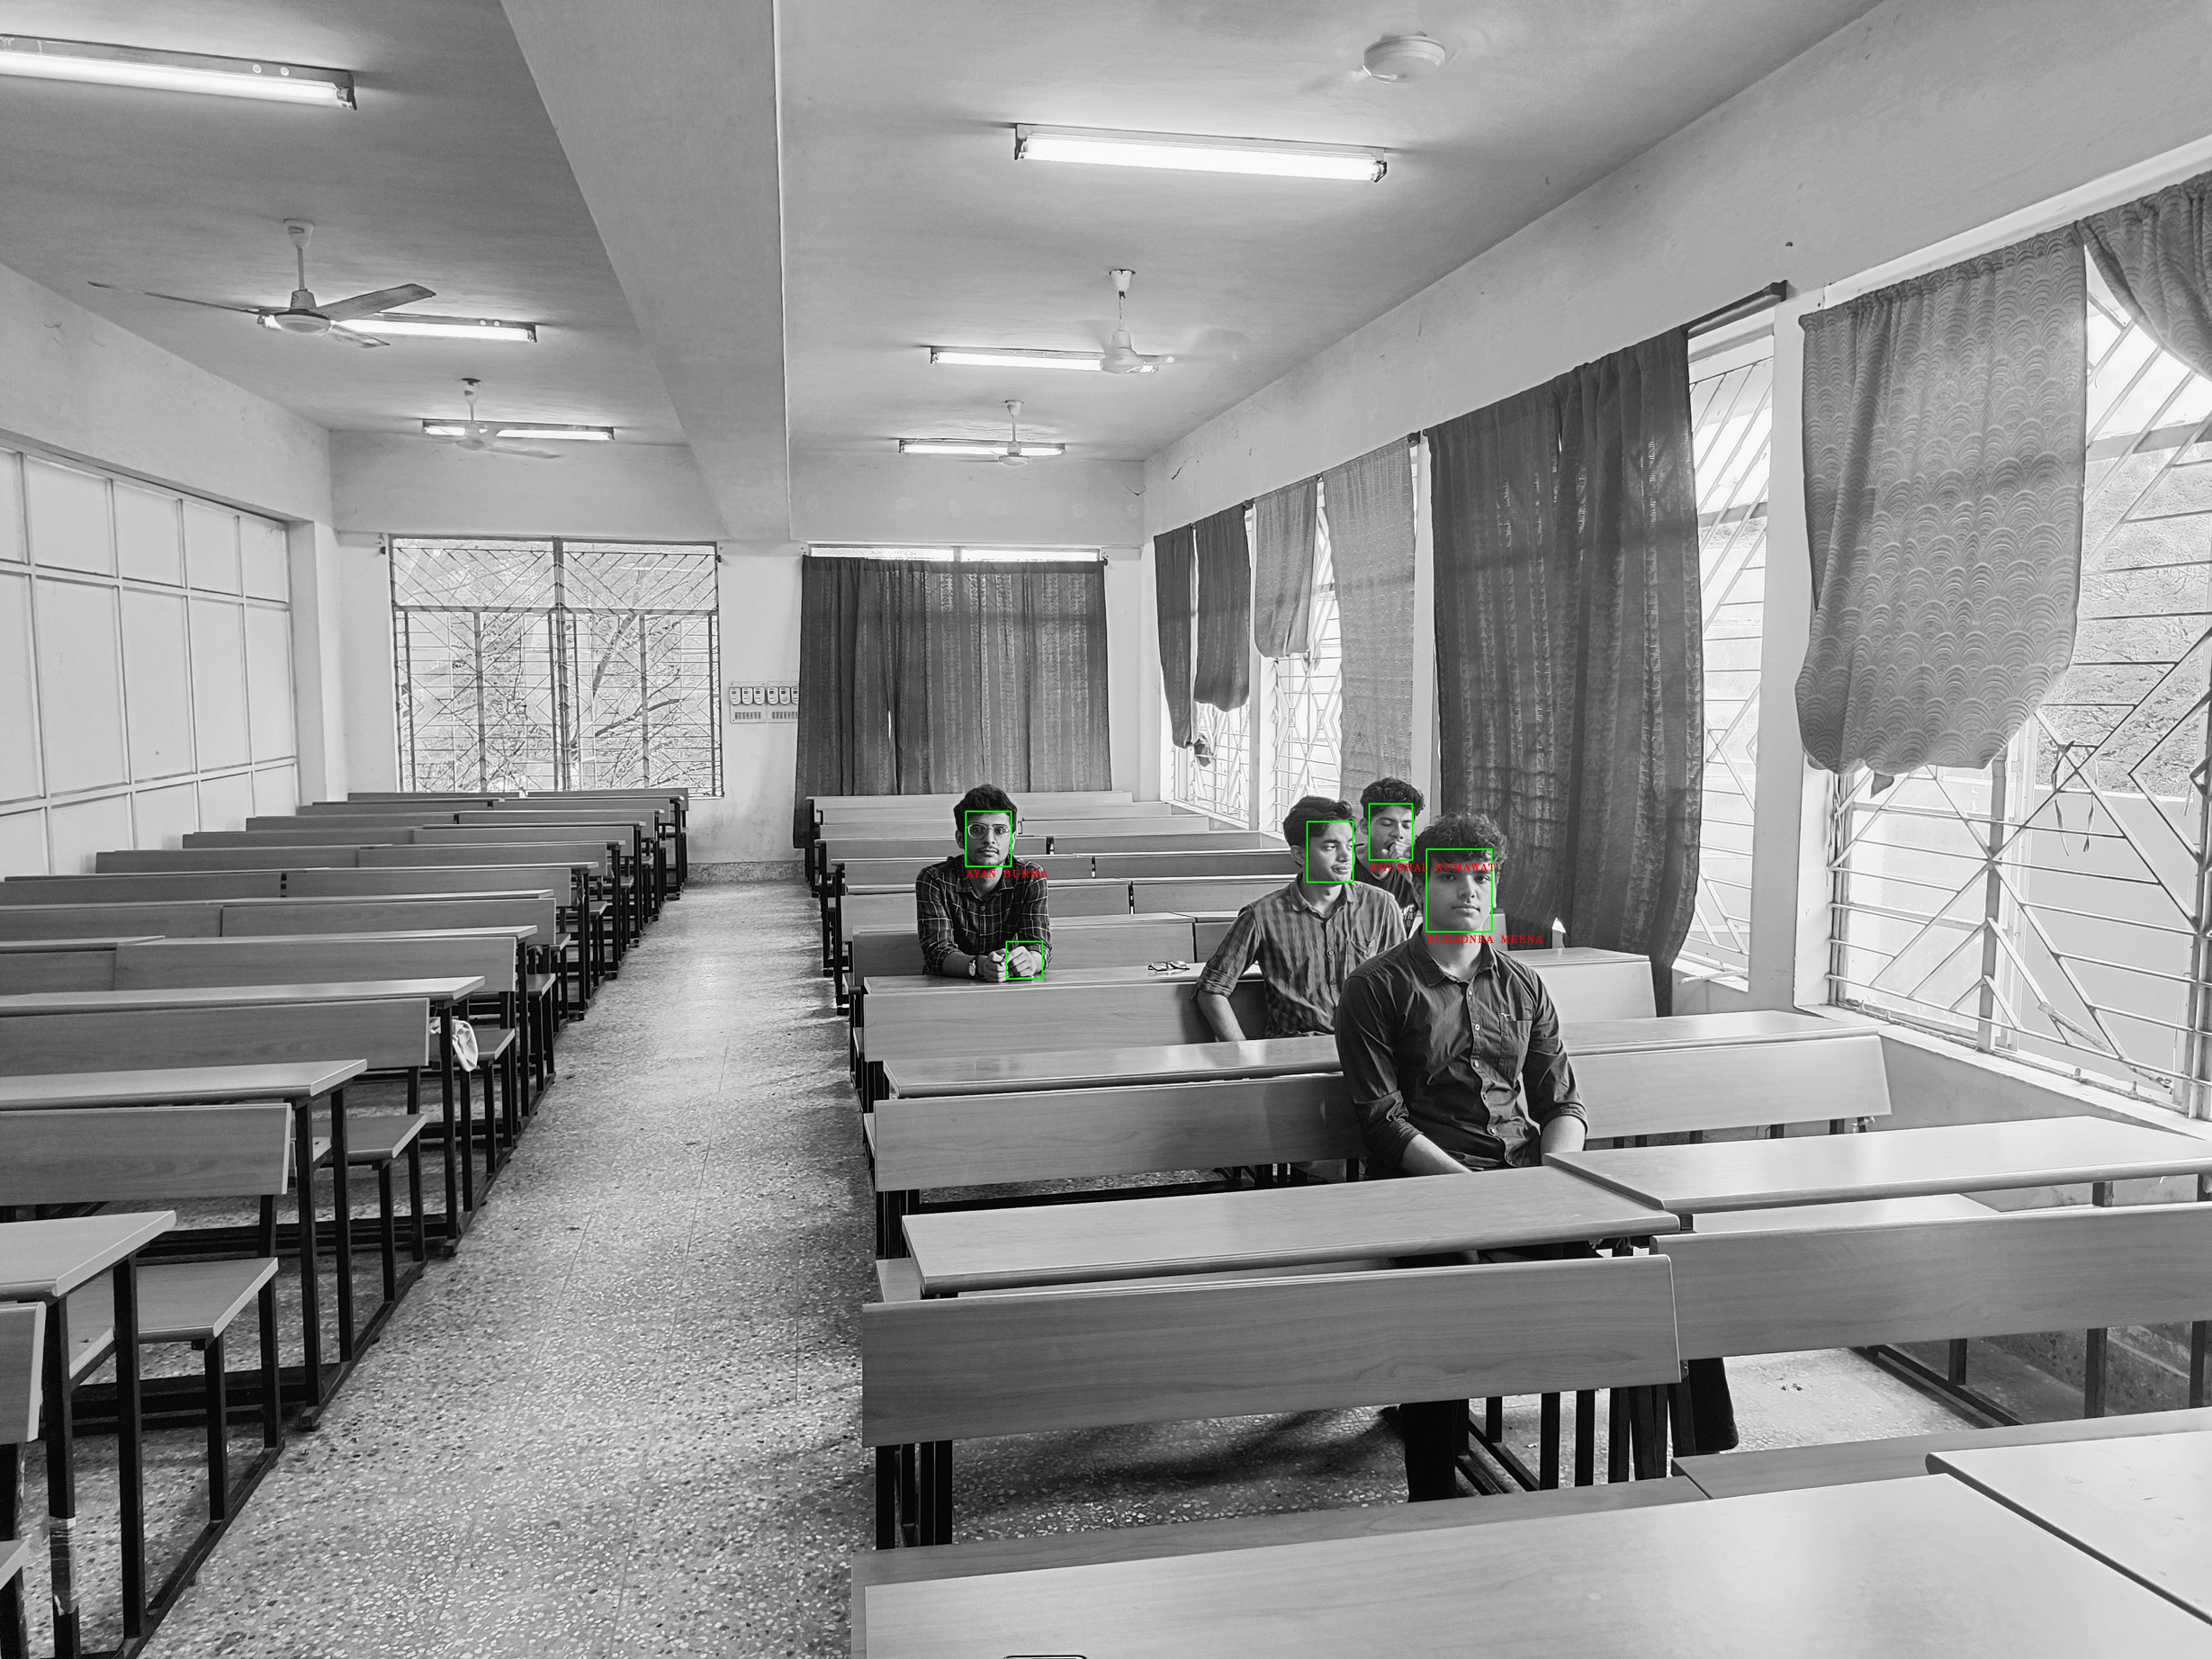
TESTING

Slide 18
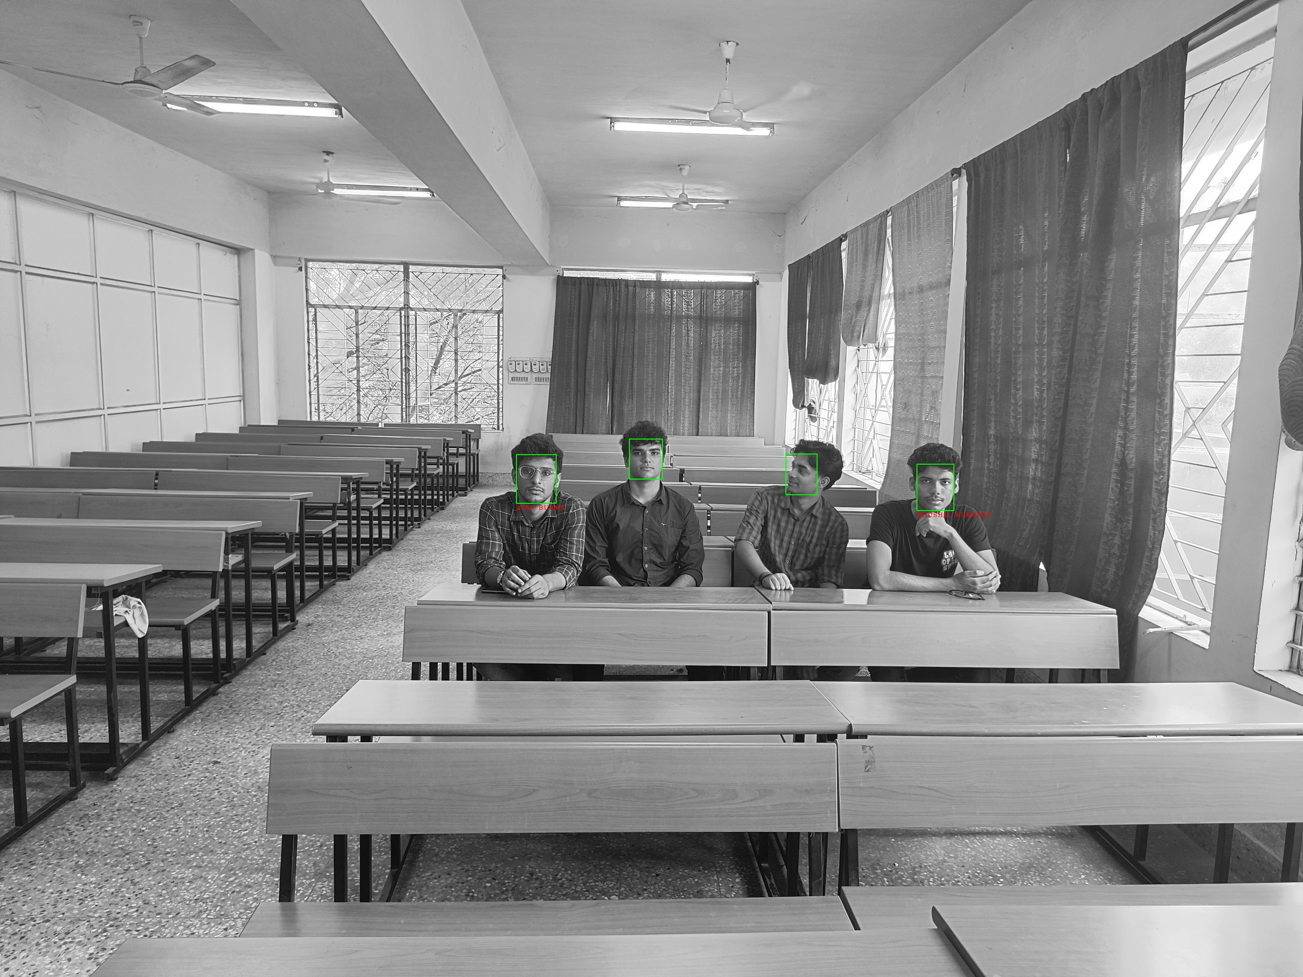
TESTING

Slide 19

DISCUSSION AND CONCLUSION
This project explored the development of a facial recognition attendance system for classrooms. Two approaches were investigated:
MTCNN and FaceNet: This approach leverages a deep learning model (FaceNet) to generate facial embeddings for recognition. It offers high accuracy but requires more computational resources for training.
SVM Classifier: This approach utilizes an SVM classifier trained on extracted facial features. It can be computationally efficient and potentially interpretable, but its performance depends heavily on feature engineering.
Both approaches achieved a promising accuracy of 94% in recognizing student faces from classroom images.

Slide 20

FUTURE WORK
Liveness Detection: Explore incorporating liveness detection techniques to mitigate potential fraud attempts using photographs or videos.
Advanced Alerting: Develop a more sophisticated alert system that differentiates between common occurrences (e.g., temporary obstructions) and suspicious activities.
Feature Engineering Exploration: Investigate and potentially experiment with different feature extraction techniques like deep feature extraction using pre-trained convolutional neural networks (CNNs) to potentially improve SVM performance for complex facial variations.
User Interface Enhancements: Implement user-friendly dashboards and reporting functionalities for instructors to easily manage and analyze attendance data.

Slide 21

REFERENCE
Mansi Singhal, Gufran Ahmad, “Deep Learning Based Real Time Face Recognition For University Attendance System”, IEEE Access, June 2023.
Shailendra, M. Singh, M. A. Khan, V. Singh, A. Patil, and S. Wadar, “Attendance management system,” in 2nd International Conference on Electronics and Communication Systems, ICECS 2015, 2015.
Cao, Q., L. Shen, W. Xie, O. M. Parkhi, and A. Zisserman, Vggface2: A dataset for recognising faces across pose and age. In 2018 13th IEEE International Conference on Automatic Face & Gesture Recognition (FG 2018). IEEE, 2018.
Dalal, N. and B. Triggs, Histograms of oriented gradients for human detection. In international Conference on computer vision & Pattern Recognition (CVPR’05), volume 1. IEEE Computer Society, 2005.

Slide 22
THANK YOU VERY MUCH!

